Slide 1
Sentiment Analysis and Post Recommendation on Reddit Data
Venkataramanan Venkateswaran - vv2265
Dhanesh Baalaji Srinivasan - ds7636 Simardeep Singh Mehta - sm11377
12/21/2023

Slide 2
Problem Statement
The project addresses two main challenges with Reddit's textual content: Firstly, performing sentiment analysis on millions of informal, slang-laden posts using advanced NLP and machine learning models. Secondly, developing an effective content recommendation system that can sift through countless posts across subreddits, learning from user interactions and content semantics to deliver relevant and engaging material to users.

Slide 3
Dataset Used
The TensorFlow Reddit dataset, comprising nearly 4 million records and totaling 18.09 GiB, features posts with an average of 270 words and summaries averaging 28 words. Key attributes include normalizedBody (formatted full post), subreddit_id (unique identifier for subreddits), subreddit (subreddit name), summary, body (entire post), content (post content minus "TLDR"), author (poster's username), and id (unique author identifier). This dataset offers a comprehensive source for natural language processing and machine learning applications related to Reddit content.

Slide 4




Technologies Used
PySpark
Used for Exploratory Data Analysis and Sentiment Analysis
Pandas and Matplotlib
Used to create plots and visualizations for better insights.
SparkML
To train the recommender system and sentiment analysis task.
Mongodb
Used to store the end results.

Slide 5
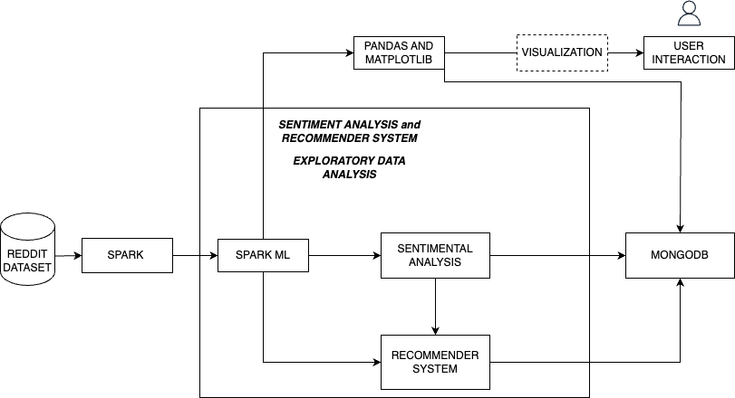
Architecture

Slide 6
Exploratory Data Analysis
01

Slide 7
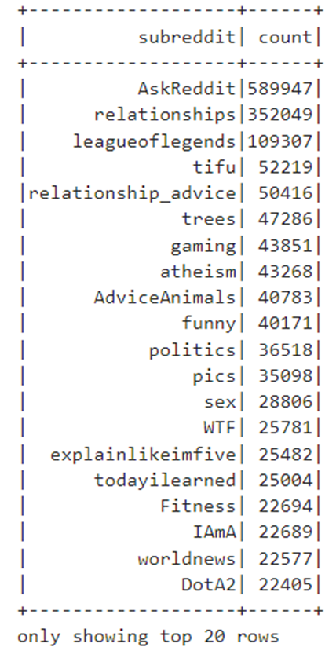
Count of posts in each subreddit
In our initial exploratory data analysis, we determined that AskReddit, relationships, leagueoflegends, tifu, and relationship_advice are the top five subreddits in terms of post volume, reflecting their activity and popularity on Reddit.

Slide 8
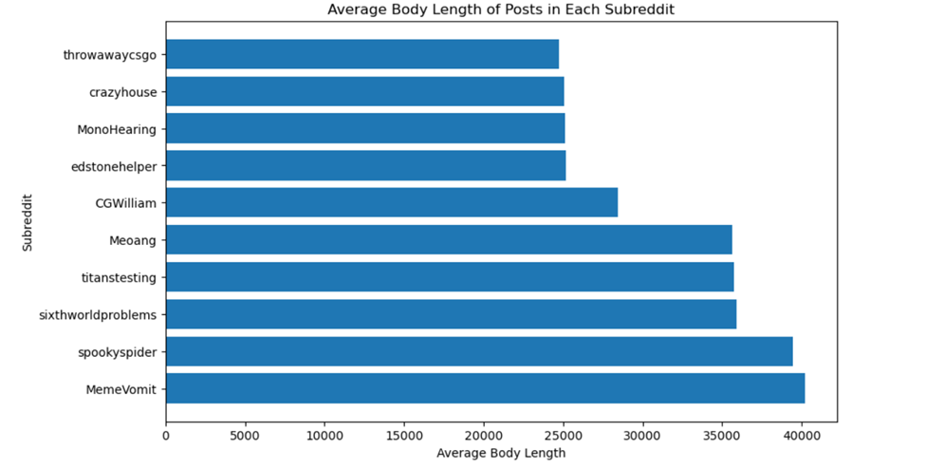
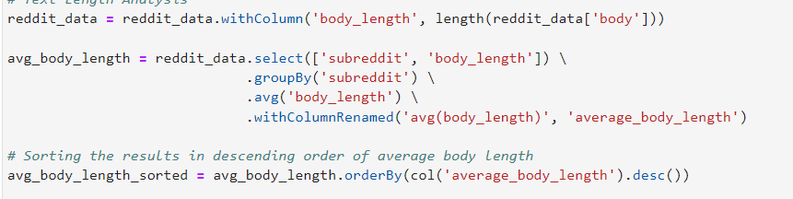
Average post length of posts in each subreddit
This analytical step examines the length of posts in various Reddit communities to gauge the depth and nature of discussions, aiding in understanding user engagement and guiding content strategy development.

Slide 9
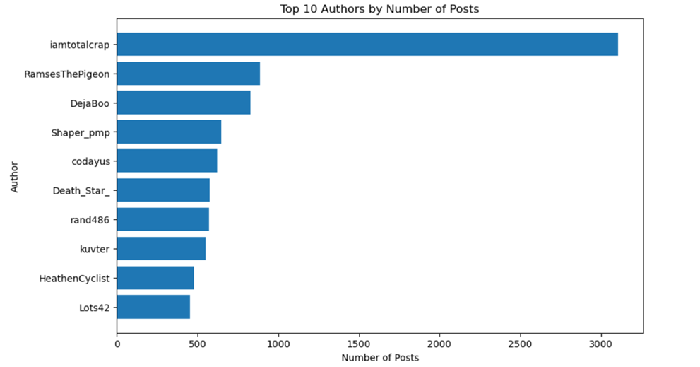
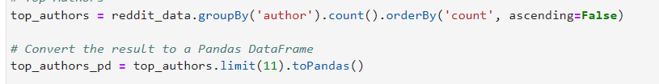
Top 10 Authors by Number of Posts
This step ranks authors by their posting frequency, aiming to identify the top 10 most active, providing insights into key contributors and content distribution within the community.

Slide 10
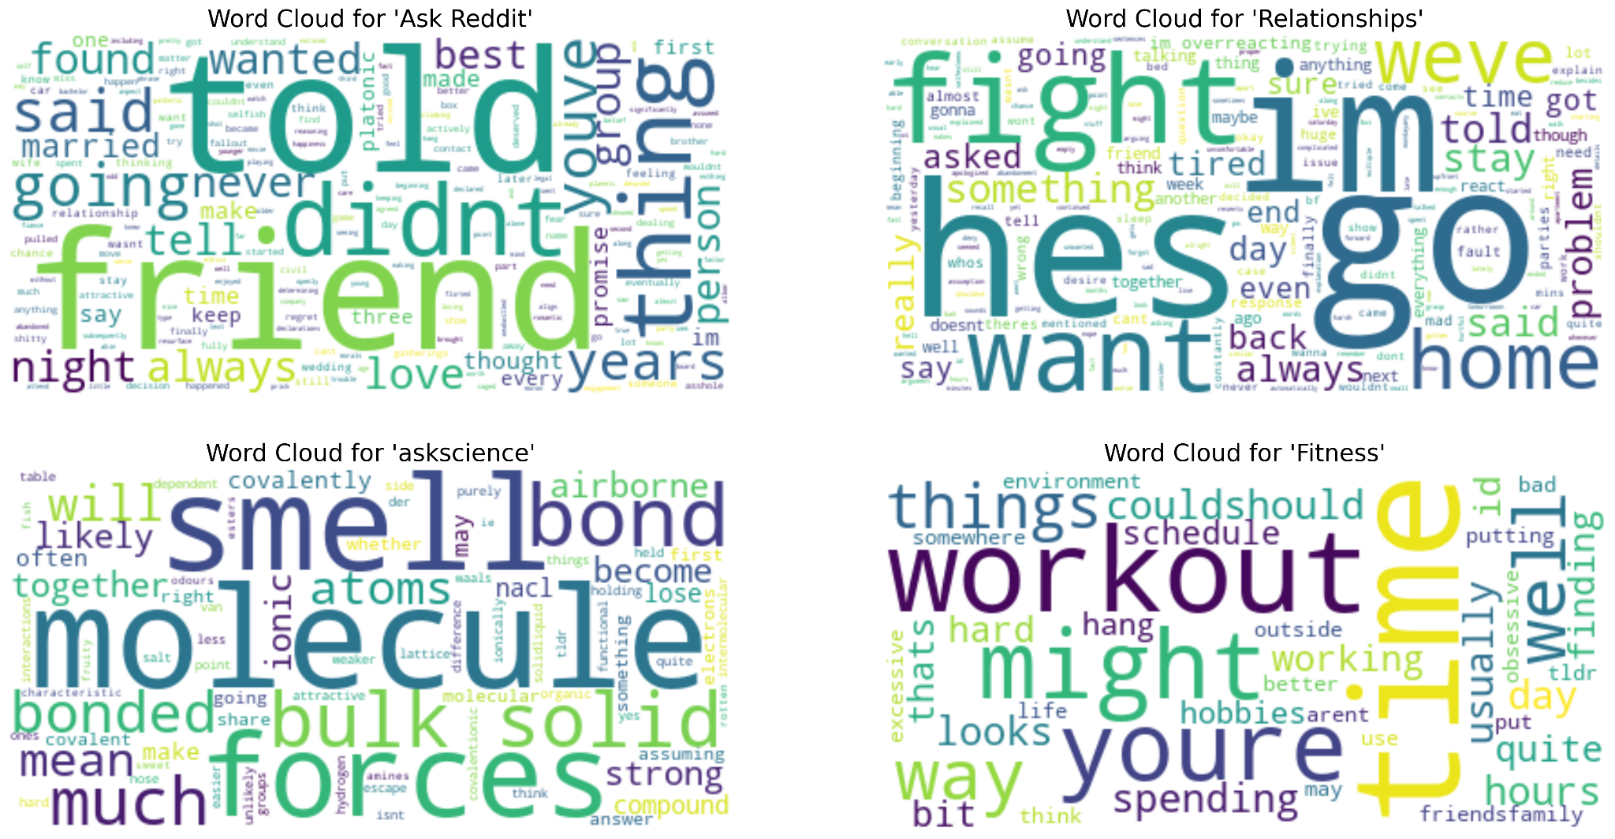
Word cloud of subreddits
Creating a word cloud in EDA visually highlights prominent subreddits in the dataset, with larger fonts signifying higher frequencies, aiding in quick identification of dominant themes and guiding further analysis.

Slide 11
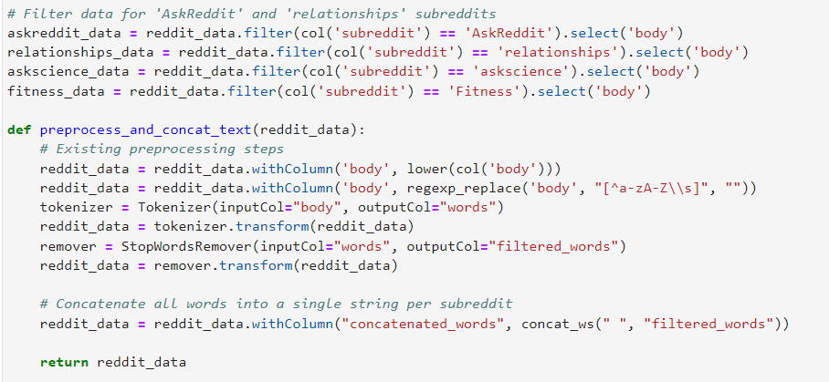
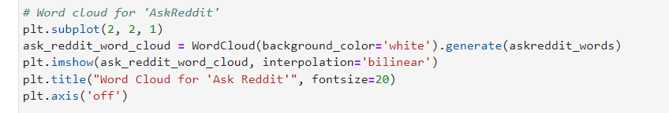
Code snippet

Slide 12
Sentiment Analysis
02

Slide 13
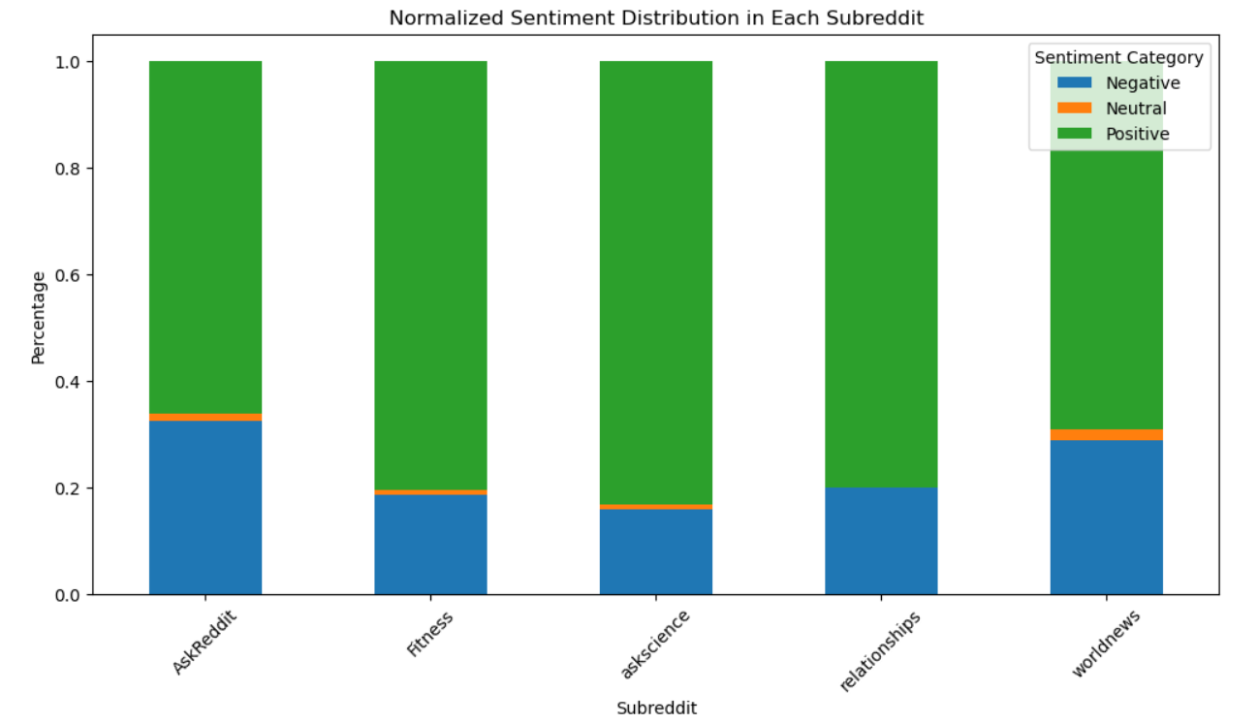
TextBlob
Sentiment analysis using TextBlob involves evaluating the emotional tone of text data. TextBlob, a straightforward natural language processing (NLP) tool, assesses text and assigns a polarity score that indicates whether the content is positive, negative, or neutral. This method is efficient for quickly gauging the overall sentiment of large volumes of text.

Slide 14
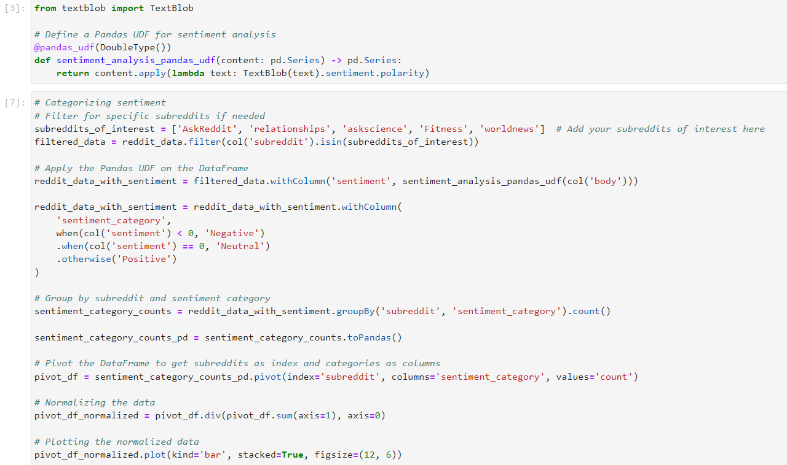
Code snippet

Slide 15
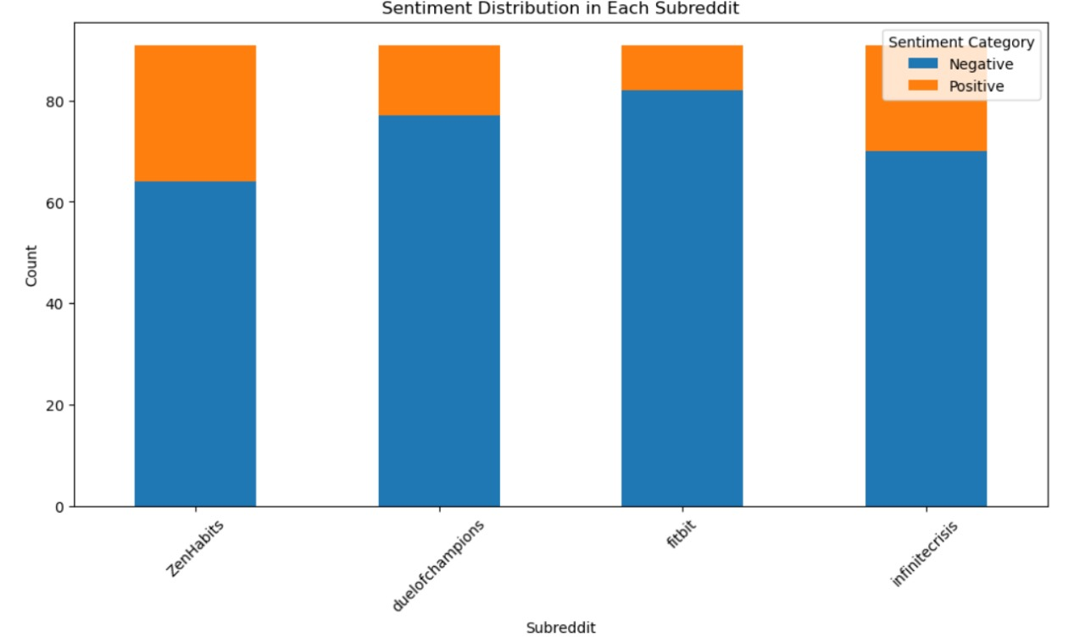
BERT
DistilBERT-based sentiment analysis is a sophisticated method that accurately classifies text as positive or negative by leveraging a refined BERT model tailored for sentiment tasks.

Slide 16
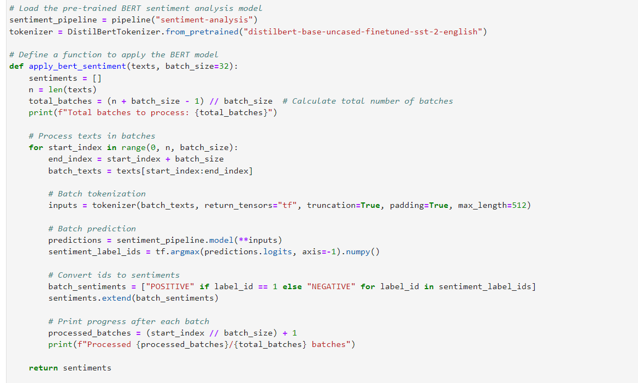
Code snippet

Slide 17
Recommendation System
03

Slide 18
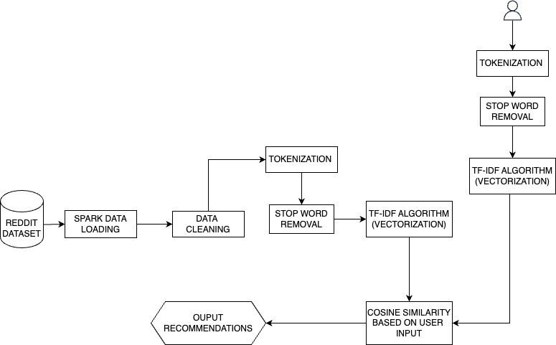
Architecture
Utilizing Apache Spark, we handle a large dataset of approximately 3.8 million subreddit entries. This stage involves cleaning and standardizing the data by removing special characters, handling missing values, and ensuring consistency.
The system processes subreddit summaries by tokenizing the text into words. Common words with low analytical value are removed. The tokenized words are then vectorized using the TF-IDF algorithm, enabling the identification of unique and significant words in the summaries, crucial for generating precise recommendations.
The core of the recommendation logic involves calculating the cosine similarity between the vectorized user input and subreddit vectors. This metric quantifies the similarity between the user’s interests and subreddit content, identifying the top 10 most relevant subreddits for personalized recommendations.
Recommendation System - Architecture flow

Slide 19
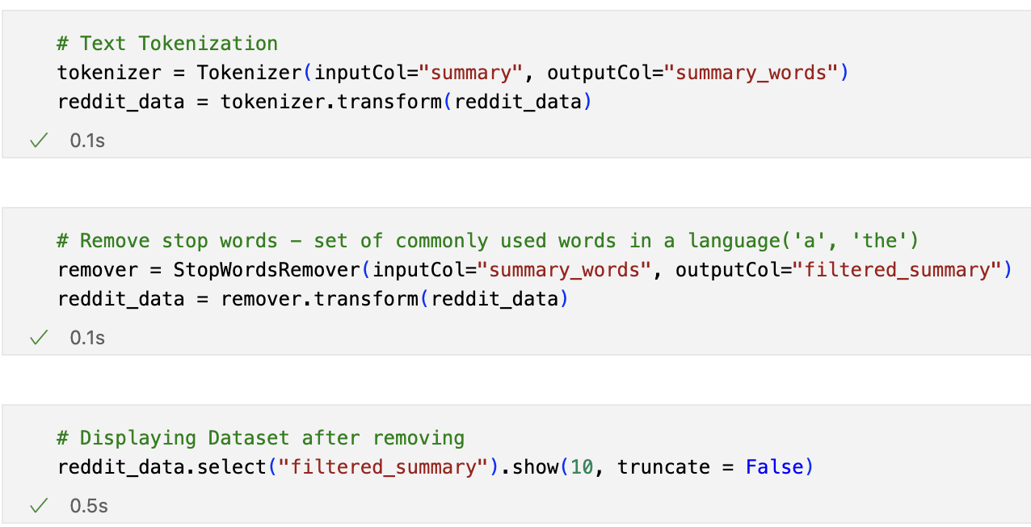
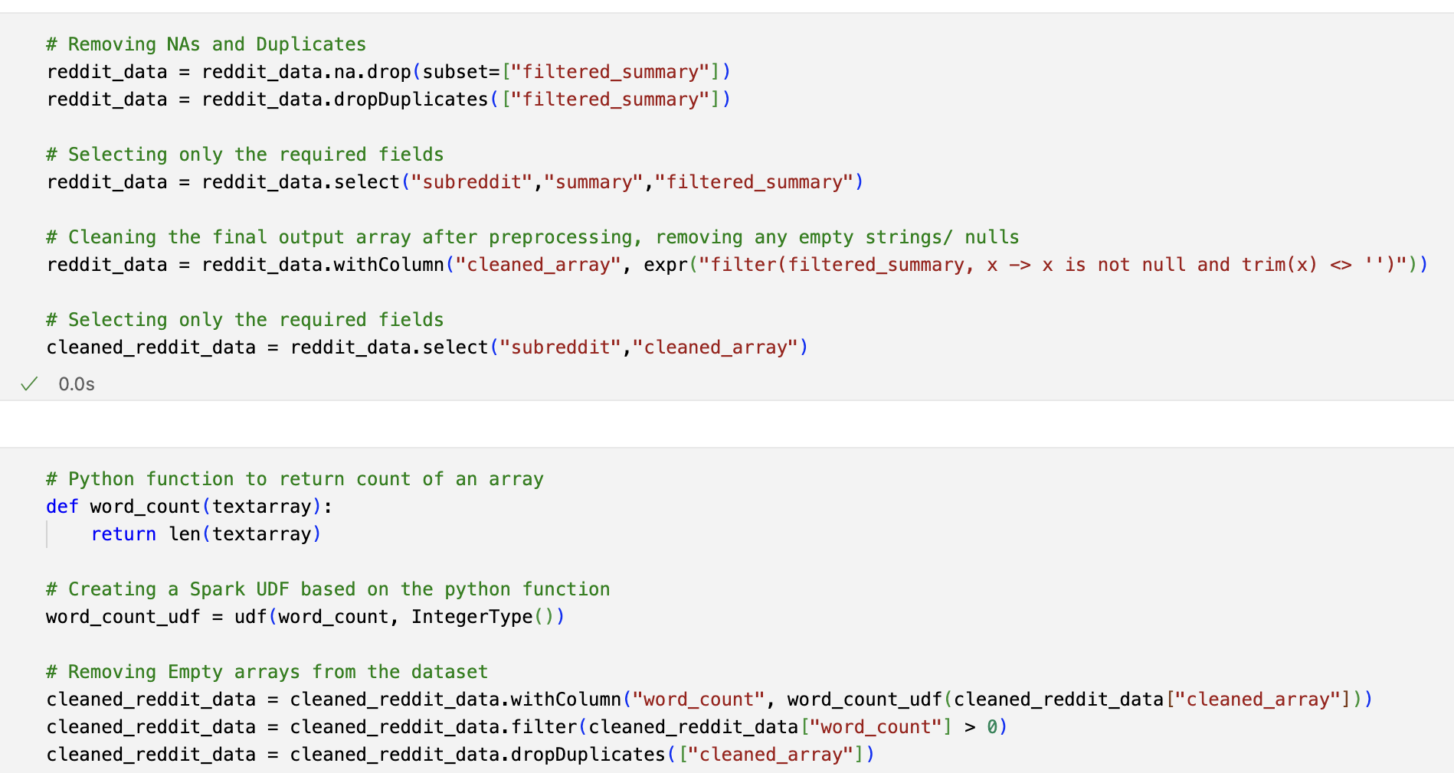
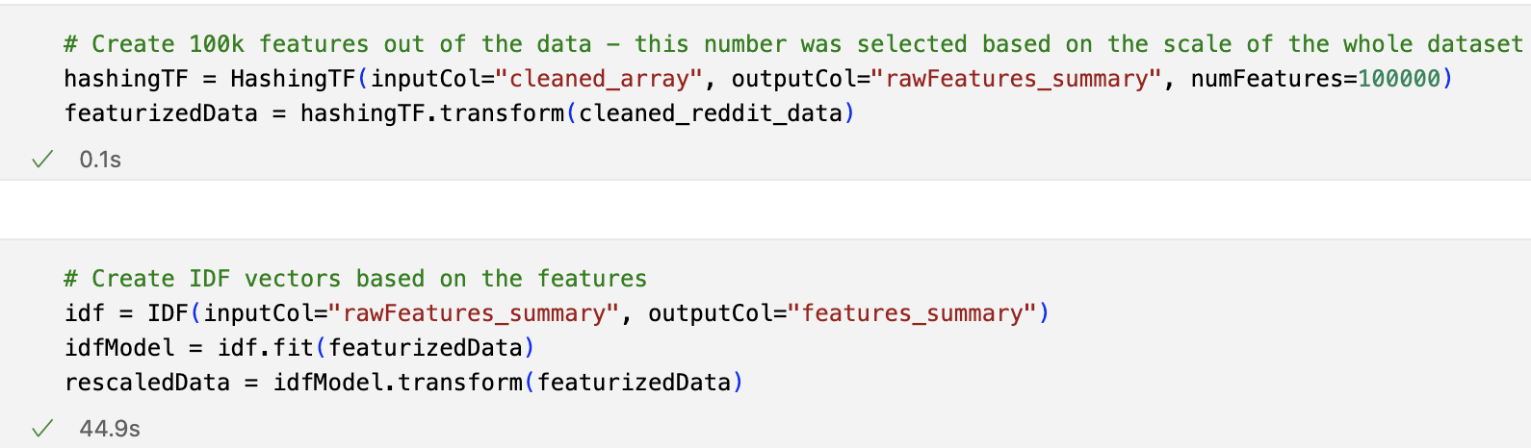
Code snippets
Tokenization and Stop word removal
Dataset cleaning and preprocessing
Creating TF IDF Vectors

Slide 20
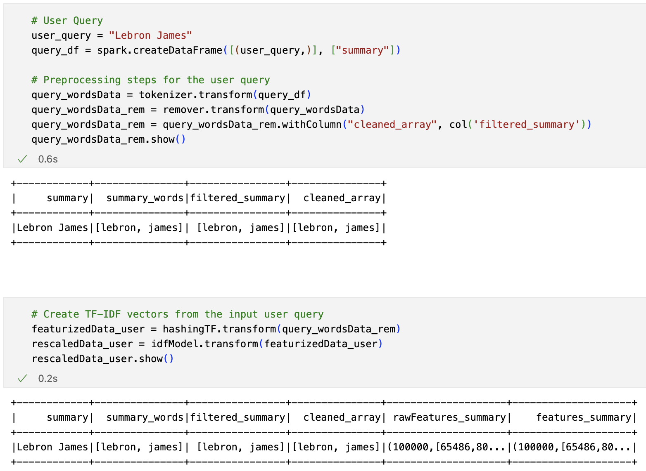
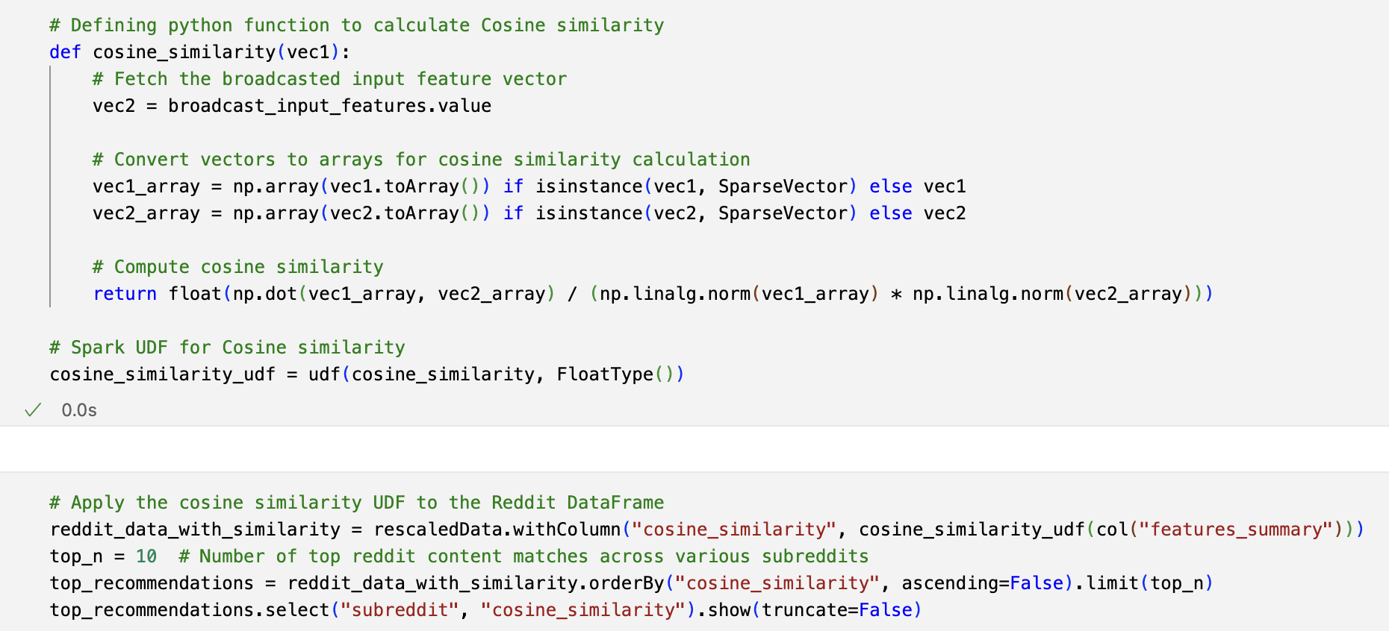
Code snippets
Creating TF IDF vectors from user query
Recommendations using Cosine similarity

Slide 21
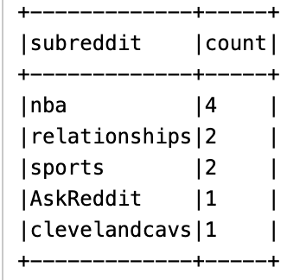
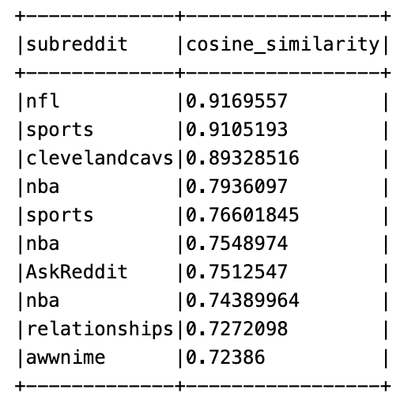
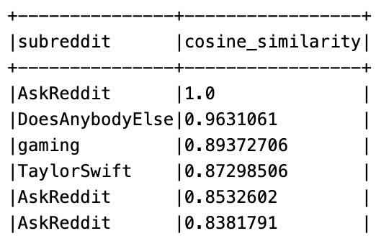
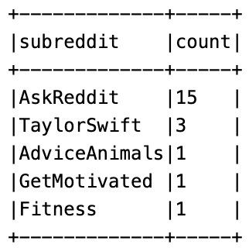
Results
Results for input query: “Lebron James”
Results for input query: “Taylor Swift”
We aggregate results for cosine similarity > 0.7

Slide 22
Limitations and Future Work
Limitations
Challenges with Static Dataset
Reddit is dynamic; static dataset may not capture recent trends.
New subreddit creations and shifts in user interests are missed.
Recommendations may not align with the latest content.
Limitations in Personalization and Complexity
Sentiment analysis is robust, but no user profiling.
Recommendations solely based on current input.
Impact: Relevance and accuracy of recommendations may suffer.
Future Work and Improvements
Incorporating Real-Time Data and User Profiling
Integrate real-time data for up-to-date recommendations.
Incorporate user profiles and historical interactions.
Result: More relevant and personalized subreddit suggestions.
Exploring Advanced Techniques for Enhanced Personalization
Investigate collaborative filtering, user behavior analysis.
Explore context-aware recommendation algorithms.
Goal: Provide a more customized user experience.

Slide 23
Conclusion
Our exploratory data analysis of the TensorFlow Reddit dataset using Pyspark, SparkML, and MongoDB has revealed key insights into Reddit's community dynamics, such as trends in post lengths, popular topics, and active authors. We performed sentiment analysis to gauge the emotional tone across subreddits, aiding in developing a tailored content recommender system. This enhanced user engagement and provided valuable insights for community moderators and marketers. Overall, our project demonstrates the impact of big data tools in analyzing and understanding complex social media interactions, significantly enriching the Reddit user experience

